Slide 1
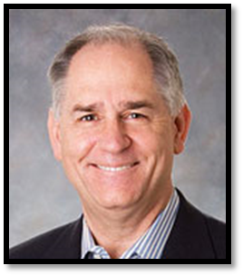


The Power of
Stay Interviews
Dick Finnegan
January 13th, 2015
Sponsored By:

Slide 2
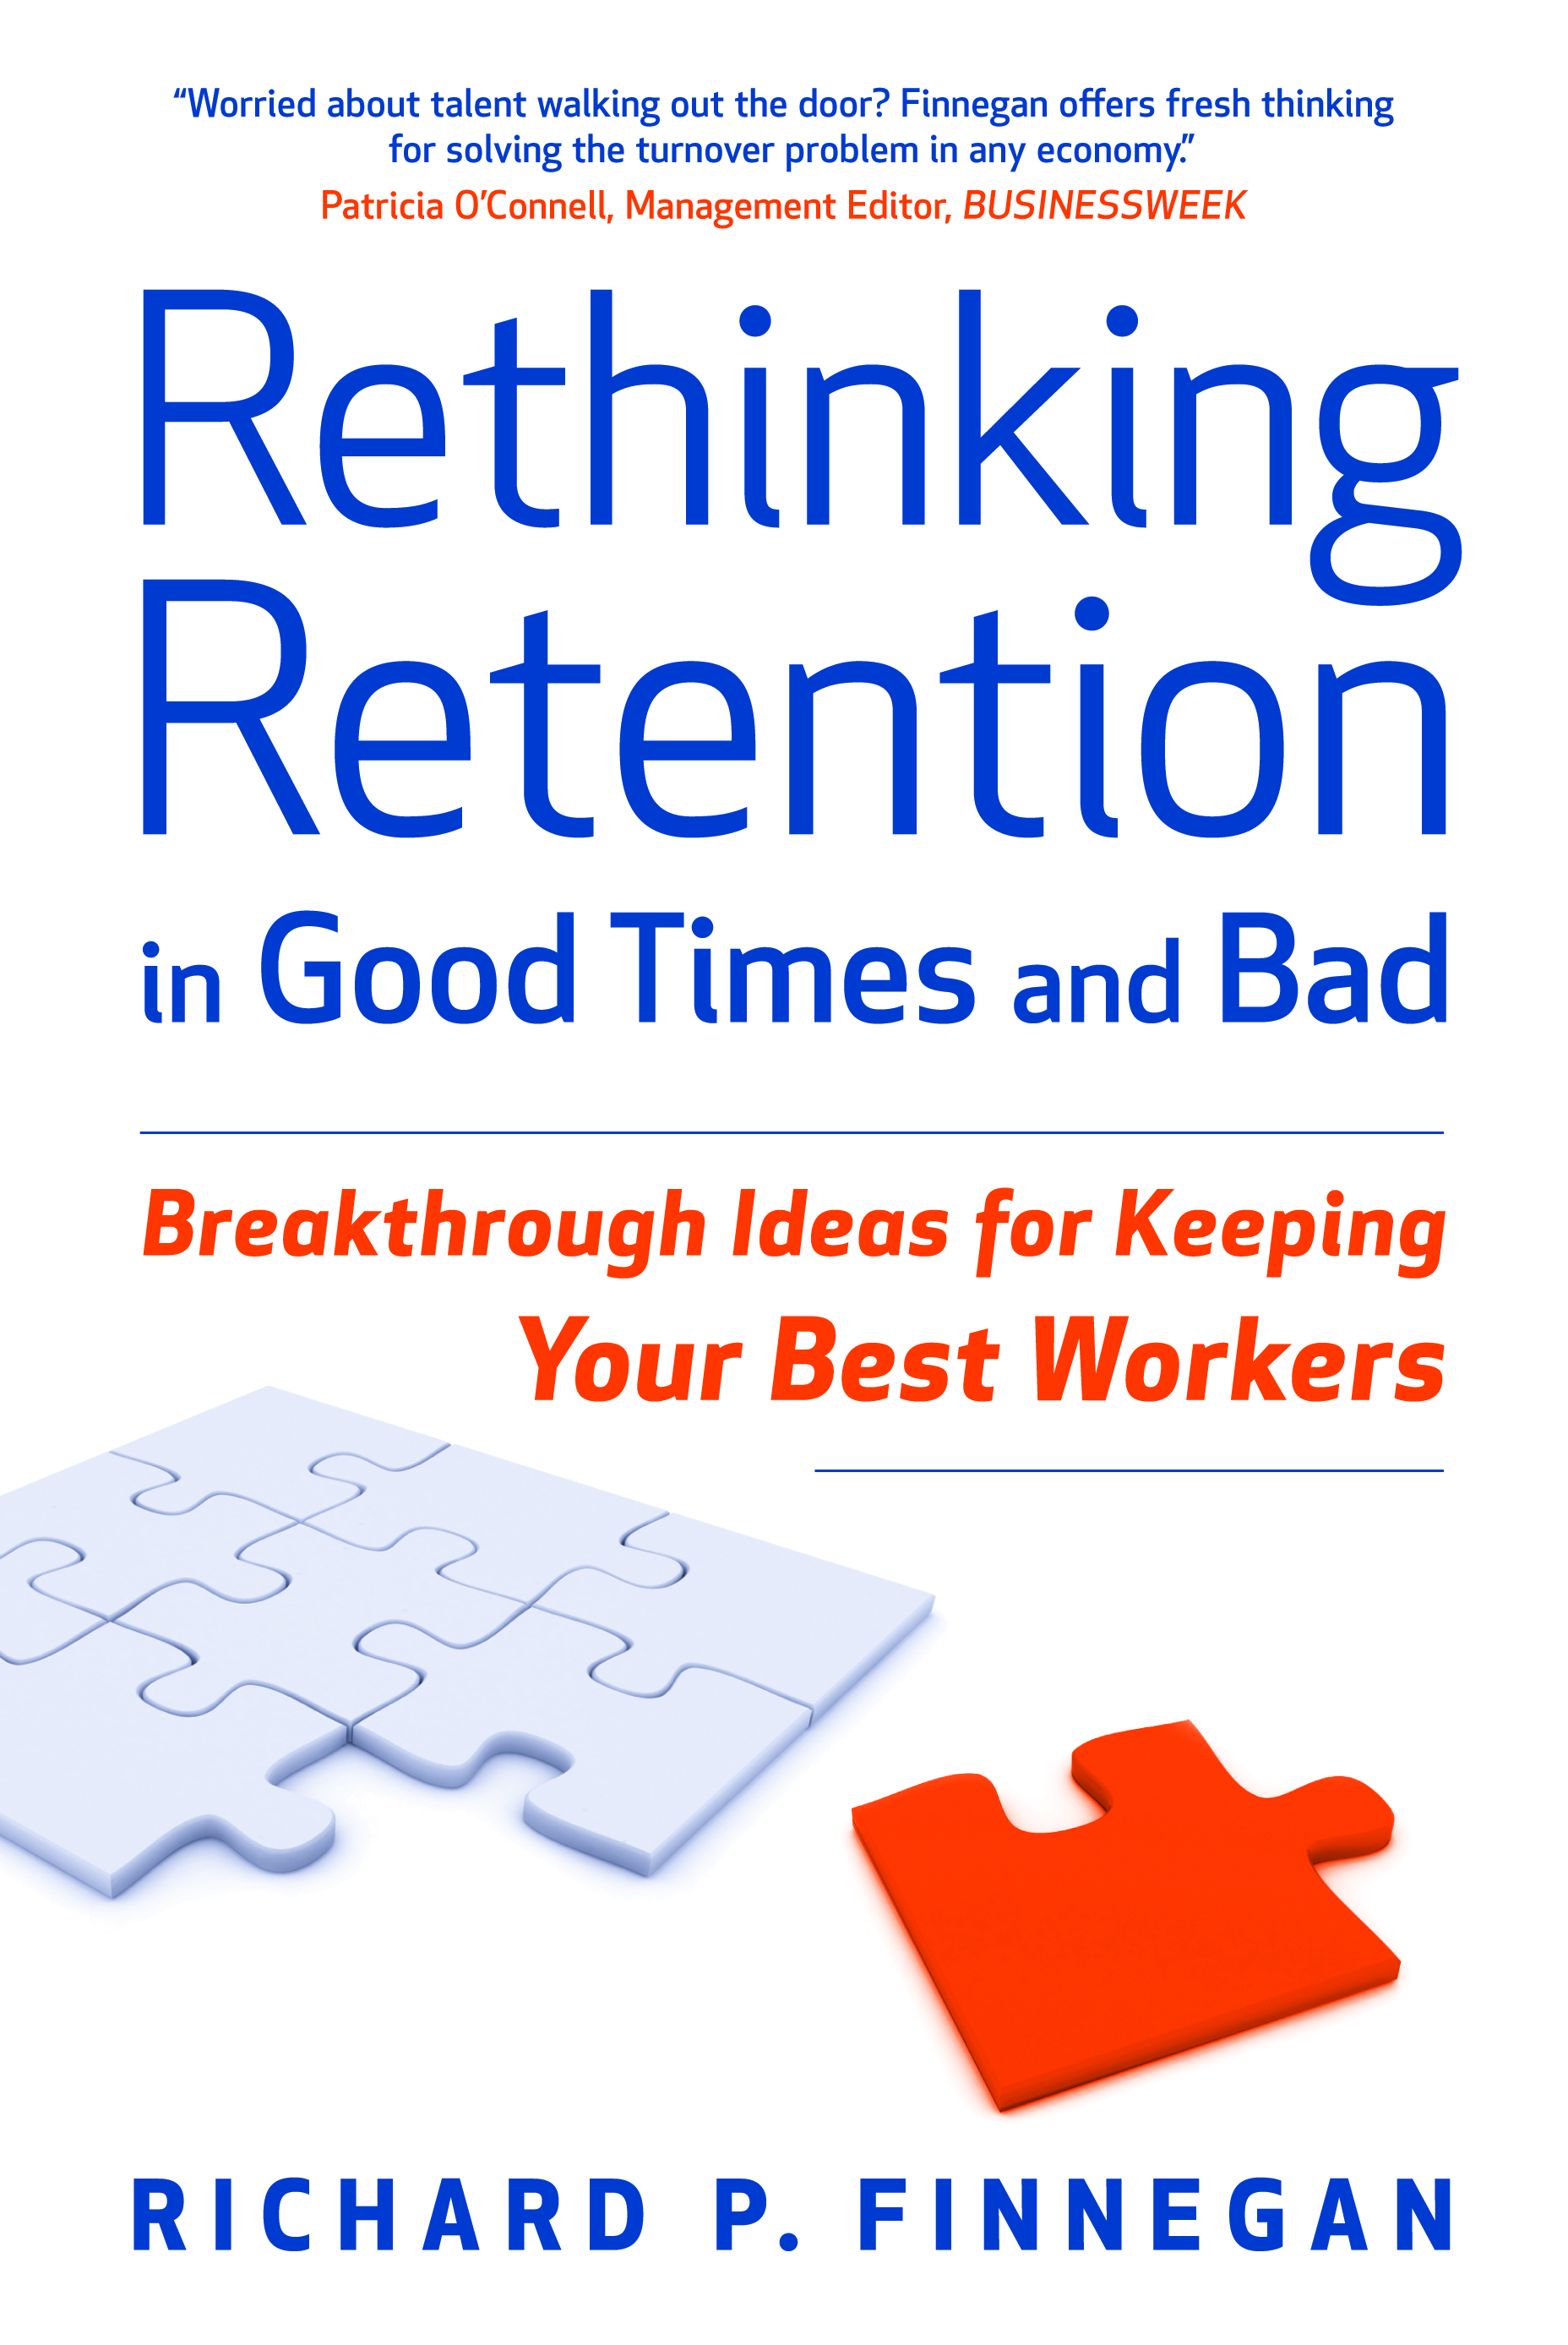
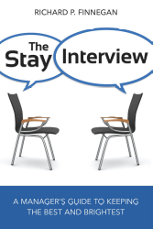
Finnegan Background
“Recovering HR director” solved turnover for Siberian banks, African gold mines, Chinese multi-national corporations…and the CIA
Author, Rethinking Retention in Good Times and Bad, endorsed by BusinessWeek as offers “fresh thinking for solving the turnover problem in any economy”
Author, The Power of Stay Interviews for Engagement & Retention,
top-selling SHRM-published book in history
Author, The Stay Interview, published January, 2015, in
20 languages + an audio book
Noted expert by BusinessWeek, Chief Executive Magazine, & Consulting Magazine
Copyright C-Suite Analytics, 2014
All Rights Reserved

Slide 3
Today’s Agenda
Stay Interviews: What & Why?
Trust Building Essentials
Stay Interview Process & Practice
Stay Action Plan & Retention Forecast
What Makes People Happy?
Notes:
Flipchart this slide
Adjust your agenda timing as needed indicating the start and end times on flipchart.

Slide 4

Stay Interviews
A Stay Interview is a structured discussion a leader conducts with each individual employee to learn the specific actions she must take to strengthen that employee’s engagement and retention with the organization
Stay Interviews…
  Bring information that can be used today
  Focus on individual employees including top performers
  Put managers in the solution seat
4
Notes:
Ask if anyone has conducted a Stay Interview as a leader? Ask if anyone has had their leader conduct a Stay Interview with them?
Introduce our definition of a Stay Interview
Emphasize that this is a tool for managers to build engagement and retention with their teams.

Slide 5
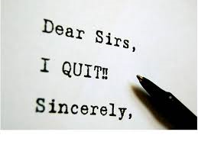
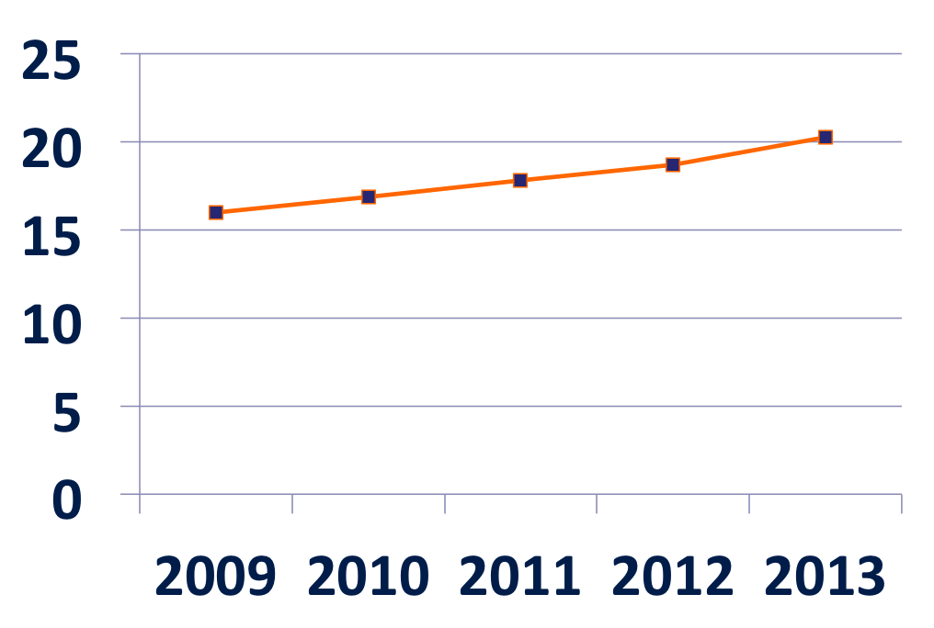
U.S. Voluntary Quit Percentages, Post-Recession…U.S. Bureau of Labor Statistics
Notes:
See the trend for voluntary quits in the US.
What are the implications for you?

Slide 6
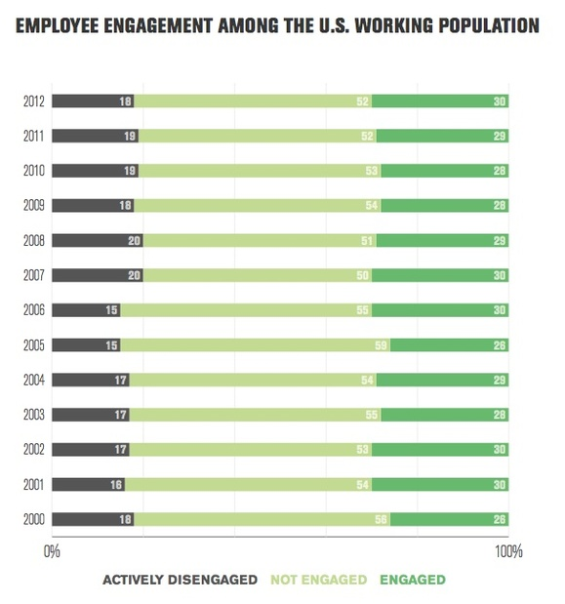
Gallup
U.S. Companies on Track to Spend $1.53 Billion Each Year to Improve Engagement…on Surveys & Programs
www.c-suiteanalytics.com

Slide 7

How Much More Do Engaged Employees Produce?
Gallup: 22% more profitability/lower turnover (TO)/higher earnings per share (EPS)
GPTW Institute: 20% more productivity/lower TO/higher EPS
Hewitt: % engaged correlates with higher shareholder returns (S/H)
Kenexa: double S/H returns
WorkUSA/Watson Wyatt: 26% more revenue per employee

Slide 8
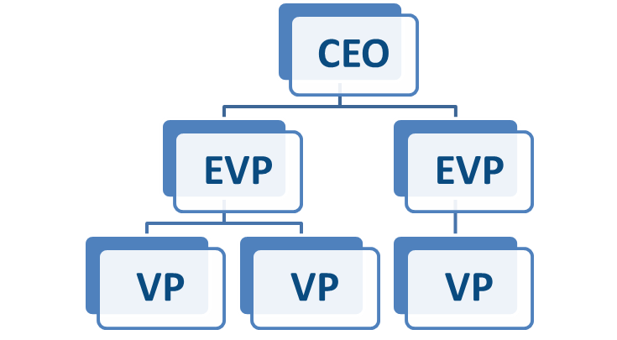
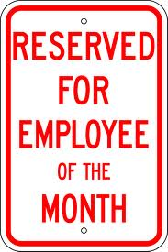
Are Your Retention Efforts Driven By Accountabilities or Programs?
Business Accountabilities driven by executives from the top like sales, service, quality, & safety
Retention Programs
driven from the side like town hall meetings, employee appreciation week, newsletters
OR…
86% of the time

Slide 9
Problem Is Clear
Exit Surveys
Employee Surveys
Engagement Surveys
Data? Yes
Solutions?
No!

Slide 10

Supervisors’ Impact on
Engagement & Retention
“If you have a turnover problem, look first to your managers”…Gallup
Employees stay for managers first and co-workers second…salary.com
Employees’ levels of engagement higher when their supervisors had higher levels of engagement…DDI
“When employees stay, it is because of their immediate managers”… National Education Association
Employees who stay primarily for their supervisors stay longer, perform better, and are more satisfied with their pay…TalentKeepers
Notes:
Many studies re-direct our attention to the power of supervisors and these are just a few.

Slide 11
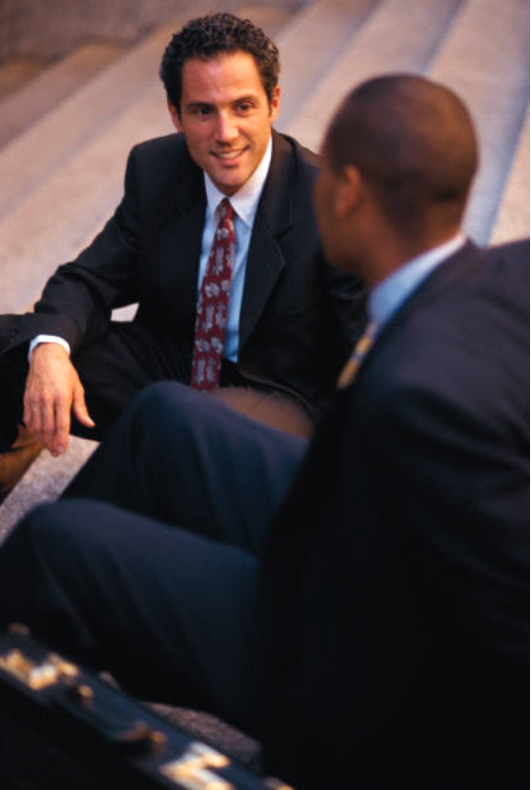
The Real Power of Supervision
A global consulting firm interviewed 1,000 recently-quit employees and asked about pay, benefits, development, advancement and relationships with supervisors…and found supervisor relationships influenced all other opinions, concluding…
“Offering a higher salary or developmental/advancement opportunity may not be enough to retain employees”

Slide 12
Which Side Matters More?
Pay, benefits, bonuses,
Employee appreciation week,
Employee of the month,
Brown bag lunches,
Leaderboard winners, career
Ladders, employee surveys,
Exit surveys, onboarding,
Training monitoring sessions,
Team meetings, all-hands
Meetings…and almost everything else
Notes:
1. Read quickly the list of common employee benefits and programs and ask how important they are for retaining employees.

Slide 13
Which Side Matters More?
Pay, benefits, bonuses,
Employee appreciation week,
Employee of the month,
Brown bag lunches,
Leaderboard winners, career
Ladders, employee surveys,
Exit surveys, onboarding,
Training monitoring sessions,
Team meetings, all-hands
Meetings…and almost everything else
Employees trust their direct supervisors on all levels throughout your organization
Notes:
1. Compare the benefits and programs to employees trusting their managers and ask which matters more.

Slide 14

Supervisors vs Programs
Good Programs + Good Supervisors =
Retention & Engagement
Good Programs + Poor Supervisors =
Turnover & Disengagement
Notes:
1. Conclude that poor, ineffective supervisors will overcome the goodness of any employee program or benefit.

Slide 15

Introducing the Power of Trust

Slide 16
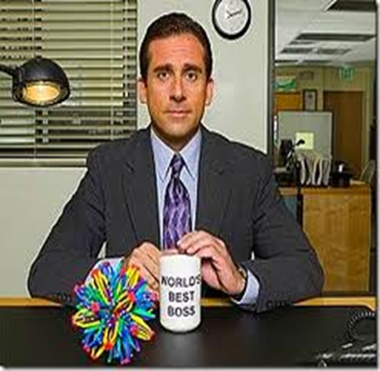
Why Was Your Best Boss
Your Best Boss?
My best boss ever was my best boss because…
____________________
____________________
____________________
Notes:
1. This is an exercise where participants recall their best boss ever and list the reasons why.

Slide 17

Why Was Your Worst Boss
Your Worst Boss?
My worst boss ever was my worst boss because…
____________________
____________________
____________________
Notes:
This is the opposite exercise, where participants recall their worst boss ever and identify the reasons why.
Ask the group if they agree with this statement: My best boss was someone I trusted and my worst boss was someone I did not.
Then ask the group if they agree with this statement: My best boss had shortcomings I easily overlooked, and my worst boss had strengths I couldn’t possibly see.
Conclude that this exercise demonstrates the power of trust on our own careers, and that building trust is by far the most important management skill.

Slide 18


The Fortune Top 100, 2014
#1:
“Google donates $50 for every five hours an employee volunteers. Last year a new program sent employees to Ghana and India to work on community projects.”

Slide 19
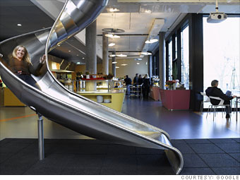
The Fortune Top 100, 2013
#1:
“The Internet juggernaut takes the Best Companies crown for the fourth time, and not just for the 100,000 hours of subsidized massages it doled out in 2012. New this year are three wellness centers and a seven-acre sports complex, which includes a roller hockey rink; courts for basketball, bocce, and shuffle ball; and horseshoe pits”

Slide 20

The Fortune Top 100, 2012
  #1:
“Employees rave about their mission, the culture, and the famous perks of the Plex: bocce courts, a bowling alley, eyebrow shaping…25 cafes, all gratis”
Notes:
1. Introduce Google as the #1 company in Fortune’s Best Companies to Work For competition in 2012. The picture and quote are from the Fortune article.

Slide 21

“Two-thirds of a company’s score is based on the results of the Great Place To Work’s Trust Index Survey”
“Any company can be a great place to work. Our approach is based on the major findings of 20 years of research – that trust between managers and employees is the primary defining characteristic of the very best workplaces.”
The Great Place to Work Institute
Notes:
Tell the group that 67% of the Fortune Top 100 score is based on the results of special survey provided by the Great Place to Work Institute, and that each Fortune Top 100 has the Institute perform this survey on a sample of their employees. Note that the survey is based entirely on how much employees trust their managers.
Conclude that although Fortune describes the outstanding benefits these companies provide, such as the picture and description of Google, the most important factor is not benefits but how much employees trust their managers.

Slide 22
Google’s Quest To Build A Better Boss
What Makes A Great Boss At
?
As published in The New York Times, March 12th, 2011
Notes:
1. Introduce Google’s study to identify what makes the best managers at Google the best.

Slide 23
Google’s Quest to Build
A Better Boss
“Technical expertise – the ability, say, to write computer code in your sleep – ranked dead last among Google’s big eight. What employees valued most were (1) even-keeled bosses who made time for one-on-one meetings, (2) who helped people puzzle through problems by asking questions, not dictating answers, and (3) who took an interest in employees’ lives and careers.”
Notes:
1. Read carefully the quote from this slide, emphasizing the best manager qualities.

Slide 24
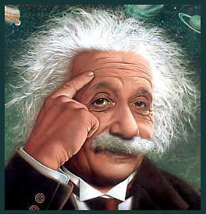
One Big Lesson Learned
It’s not what you give them, it’s how you treat them…and firstline supervisors most influence employees’ relationships with managers, colleagues, and duties
Insanity: Doing the same thing over and over again and expecting different results

Slide 25
Stay Interviews
A Stay Interview is a structured discussion a leader conducts with each individual employee to learn the specific actions she must take to strengthen that employee’s engagement and retention with the organization
Stay Interviews…
  Bring information that can be used today
  Focus on individual employees including top performers
  Put managers in the solution seat
25
Notes:
Ask if anyone has conducted a Stay Interview as a leader? Ask if anyone has had their leader conduct a Stay Interview with them?
Introduce our definition of a Stay Interview
Emphasize that this is a tool for managers to build engagement and retention with their teams.

Slide 26

Stay Interviews Vs Survey Staples
Exits
Engagement
Too long
Don’t reveal truths
“Better opportunity”
No follow-up
No changes…autopsies!
Average thinking vs top performers
Opinions vs importance
Long delays
Annual temperature checks
Short-term, feel-good programs…don’t build sup skills

Slide 27


3 Stay Interview Success Stories
  Florida Hospital Zephyrhills…All turnover 37%; nurse turnover 70%
  Burcham Hills Retirement Community…Nurse turnover 70%; 100% retention first 180 days
  Novo 1 Call Centers…Agent turnover 20%
27

Slide 28
Stay Interview Process Key Ingredients
Conducted by supervisors vs. HR
Separate from Performance Review
Repeat each 6 months for all existing employees / 2 times a year for new hires with first one in first 90 days and a second one at 180 days
Script opening, questions, probes, closing
Create individual Stay Action Plans
Managers Forecast Retention
28
Notes:
Emphasize key ingredients as listed, emphasizing that top managers go first with their teams so each middle manager begins as an “employee” first.
All Stay Interviews are conducted by managers and not by human resources.
Stay Interview meetings are held separately from performance reviews and do not include any performance discussions.
Scripts are provided and will be presented soon.
Stay Interviews can be implemented for all employees, one division, or just high performers.
Tools are provided to record Stay Interview results on the department and company levels.
Stay Interviews should become part of a permanent process, provided several times in the first six months for new hires and at least annually for all employees.

Slide 29

The 4 Stay Interview Skills
Skill #1: Always take notes
Skill #2: Be a great listener
Skill #3: Remember to probe
Skill #4: Take responsibility

Slide 30

Stay Interview Schedules
Immediately and at least once annually
New hires at 60 and 120 days
Disconnected from performance discussions

Slide 31
Stay Interview Action Plans
What I will do…
What employee will do…
By when…
And we meet again on…

Slide 32
Retention Forecast “HeatMap”
Leader: Rodriguez | Perf Rating/ 5 Hi, 1 Lo | Green 1+ yrs | Yellow 6-12 Months | Red 0-6 Months | Retention Plan
Kim Johnson | 4 |  |  |  | Provide mentor for…
Burt Brown | 5 |  |  |  | Develop skills for possible promotion to…
Cindy Stone | 3 |  |  |  | Pleased with current role & circumstance
Ralph Jimenez | 2 |  |  |  | Coaching for performance
32

Slide 33

Gallup’s 100 Year Commitment
Surveying citizens of the world to learn what brings most happiness over 100 years. So far the answer is which…
a. Good health?
b. A good job?
c. Love and respect from others?
d. Money for needs and more?
e. Better life for your children?

Slide 34

Gallup’s 100 Year Commitment
a. Good health
b. A good job
c. Love and respect from others
d. Money for needs and more
e. Better life for your children

Slide 35
Blunt Finish
Jim Clifton, CEO, Gallup…
“Let’s get rid of managers from hell, double the number of great managers & engaged employees, and have those managers lead on what actually matters…The country’s employees will be twice as effective, they’ll create far more customers, companies will grow, spiraling healthcare costs will decrease, and desperately needed GDP will boom like never before.”

Slide 36
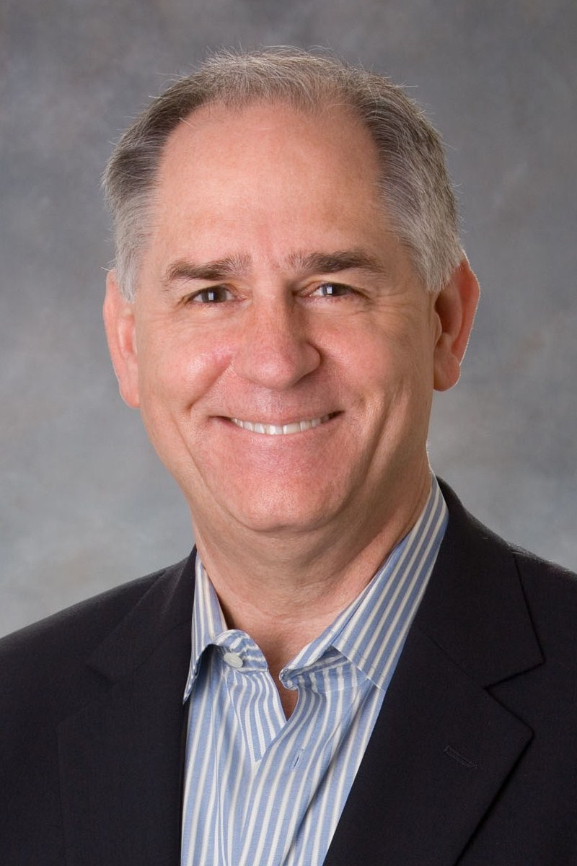
To Obtain
How to Cost Turnover & Engagement
Engagement Correlations to Productivity
The Stay Interview Manager
Training Game
Please Email Me/Include # of Employees
DFinnegan@C-SuiteAnalytics.com

Slide 37
Ardy Assadi
Director
289-301-4561
ardy@halcyonfinance.ca
www.halcyonfinance.ca

